Slide 1
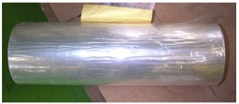
Jumbo wind-up improvements
Define
Measure
Analyze
Improve
Control
In addition to creasing along the length of a Jumbo roll, wrinkles were observed across the width of the Jumbo towards the core end of the production run
These were proved to be ‘Air Buckles’ where air is entrapped between each lap of material on wind-up of the Jumbo and the end weight of the Jumbo causes it to collapse on itself or ‘Buckle’ (see below)
The application of a nip pressure through use of a Contact Roller was used to eliminate this at an optimum pressure setting of 0.5kg

Slide 2
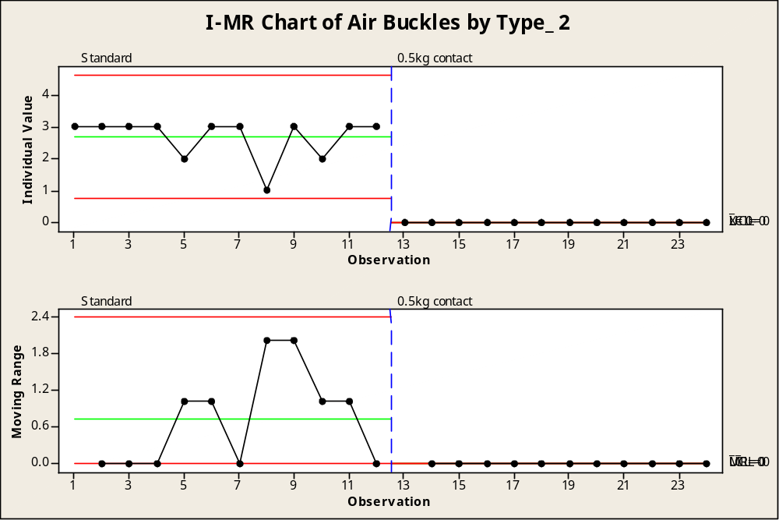
Jumbo wind-up improvements
Define
Measure
Analyze
Improve
Control
Reduction in Air Buckles through use of a Contact Roller

Slide 3
Jumbo wind-up improvements
Define
Measure
Analyze
Improve
Control
Poor cloth and film alignment was observed to have caused creasing in Jumbos and so a Quality Alert was raised and all operators briefed as to the importance of alignment before adhesive application

Slide 4

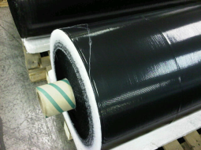
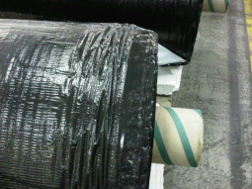
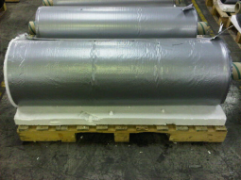
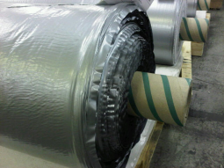
Be sure that cloth and film are aligned correctly before applying adhesive. Below are examples of incorrect alignment:
QUALITY ALERT!

Slide 5
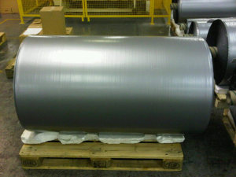
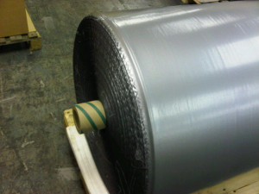
Be sure that cloth and film are aligned correctly before applying adhesive. Below are examples of correct alignment:
QUALITY ALERT!

Slide 6
Jumbo wind-up improvements
Define
Measure
Analyze
Improve
Control
It was observed that since the standardisation of the Taper Tension profiles on the AT Calender the creasing in Jumbos was caused during the Turret and Cut-off cycle
Trials were conducted using a Bowed Spreader Roller in place of the standard idle roller currently in use
It was noted that although some initial creasing appeared at the beginning of the Turret cycle, it was eliminated upon contact with the Bowed Roller unlike the standard idle roller

Slide 7
Jumbo wind-up improvements
Define
Measure
Analyze
Improve
Control
A new Works Instruction has been created explaining the procedure for running products with the Contact Roller in operation to eliminate air buckles. Teams were briefed week 18
New Bowed Rollers were fitted to the jumbo wind-up station during week 28 Turret Cycle to aid elimination of in-line creasing.

Slide 8
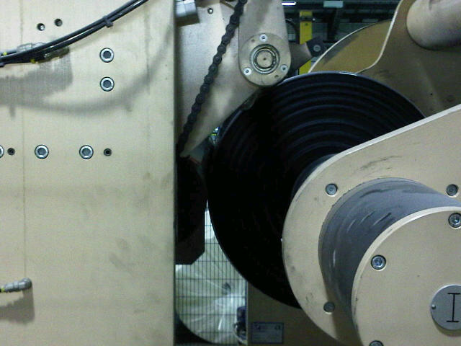
Progress so far…
Define
Measure
Analyze
Improve
Control
11/04/2011: AT Calender cloth alignment Quality Alert and Team Briefing
03/05/2011: Contact Roller in use after successful trials
w/c 11/07/2011: New bowed rollers fitted during this week.

